Slide 1


Survey of Multiple Choice Question Answering Systems
Vikas Yadav

Slide 2
Task: question answering
Which instrument measures atmospheric pressure?

Slide 3
Task: question answering
Which instrument measures atmospheric pressure?
Barometer

Slide 4
Flavors of QA: Multiple-choice QA
AI2’s Reasoning Challenge (ARC) (Clark et al., 2018)
Question: Which change in the state of water particles causes the particles to become arranged in a fixed position ?
A] Boiling B] Melting C] Freezing D] Evaporating
Notes:
Speak out the example.

Slide 5
Flavors of QA: Multi-hop QA
Multiple sentence reading comprehension (MultiRC) (Kashabi et al., 2018)
(SENT 0): The driver of the Facel Vega car, Michel Gallimard, who was Camus’s publisher and close friend, also died in the accident.”, (SENT 1): ”In August 2011, the Milan newspaper Corriere della Sera reported a theory that the writer had been the victim of a Soviet plot, but Camus’s biographer, Olivier Todd, did not consider it credible.”, (SENT 2): ’Camus was buried in the Lourmarin Cemetery, Lourmarin, Vaucluse, France.’, (SENT 3): ’He was the second-youngest recipient, at the age of 44, of the Nobel Prize in Literature, after Rudyard Kipling, at the age of 42.’, (SENT 4): ’He was survived by his wife and twin son and daughter, Jean and Catherine, who hold the copyrights to his work.’, (SENT 5): ”Two of Camus’s works were published posthumously.”, (SENT 6): ”The first, entitled A Happy Death (1970), featured a character named Patrice Meursault, comparable to The Stranger’s Meursault.”, (SENT 7): ’There is scholarly debate as to the relationship between the two books.’, (SENT 8): ’The second was an unfinished novel, The First Man (1995), which Camus was writing before he died.’, (SENT 9): ’The novel was an autobiographical work about his childhood in Algeria.
Question - Which novel did Camus write about his childhood in Nigeria?
Answer - The First Man
Notes:
Speak out the example.

Slide 6
Flavors of QA: sentence selection
WikiQA (Yang et al., 2015)
Question: how does a water pump work?
A large, electrically driven pump (electropump) for waterworks near the Hengsteysee , Germany.
Pumps operate by some mechanism (typically reciprocating or rotary), and consume energy to perform mechanical work by moving the fluid.
A pump is a device that moves fluids (liquids or gases), or sometimes slurries , by mechanical action.
Notes:
Just speak the questiona and the correct answer.

Slide 7
Flavors of QA: reading comprehension
SQuAD (Rajpurkar et al., 2016)
In meteorology, precipitation is any product of the condensation of atmospheric water vapor that falls under gravity. The main forms of precipitation include drizzle, rain, sleet, snow, graupel and hail... Precipitation forms as smaller droplets coalesce via collision with other rain drops or ice crystals within a cloud. Short, intense periods of rain in scattered locations are called “showers”.
Question - Where do water droplets collide with ice crystals to form precipitation?
Answer – “within a cloud”
Notes:
Just speak the questiona and the correct answer.

Slide 8
Flavors of QA: Maths QA
Closed-vocabulary algebra: Suppose 3x + y = 15, where x is a positive integer. What is the difference between the largest possible value of y and the smallest possible value of x, assuming that y is also a positive integer?
Open-vocabulary algebra: At a basketball tournament involving 8 teams, each team played 4 games with each of the other teams. How many games were played at this tournament?
Geometry: The lengths of two sides of a triangle are (x − 2) and (x + 2), where x > 2. Which of the following ranges includes all and only the possible values of the third side y?
(A)0<y<x(B)0<y<2x(C) 4 < y < 2x
Example taken from Hopkins et al. (2019)
Notes:
Just speak the questiona and the correct answer.

Slide 9
Our focus – Multiple choice QA
Information Systems
Data Sciences

Slide 10
Applications:
Notes:
So, it is clear that humans cannot keep up with so much information, coming from so many domains!
And if that’s case then machines must help!

Slide 11
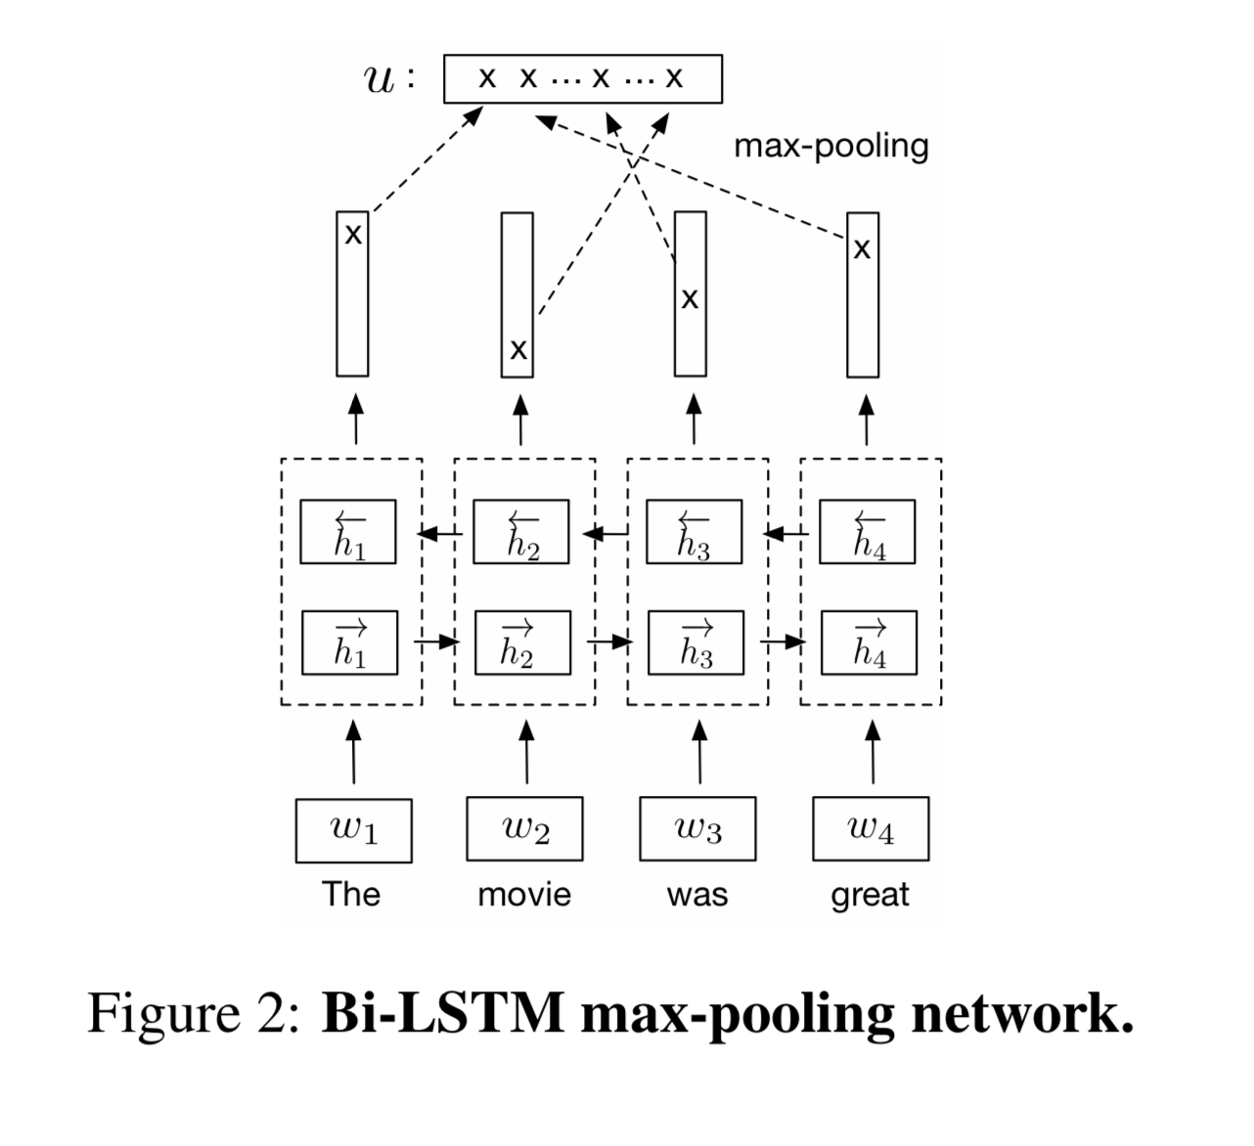
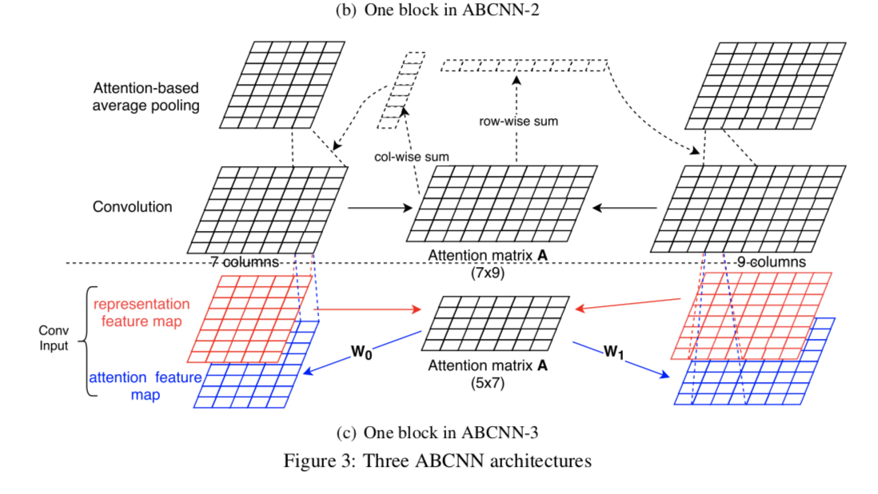
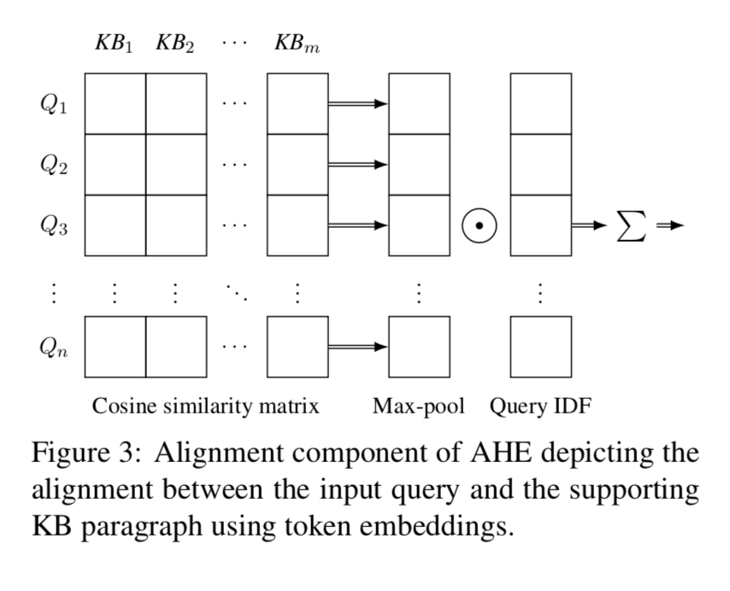
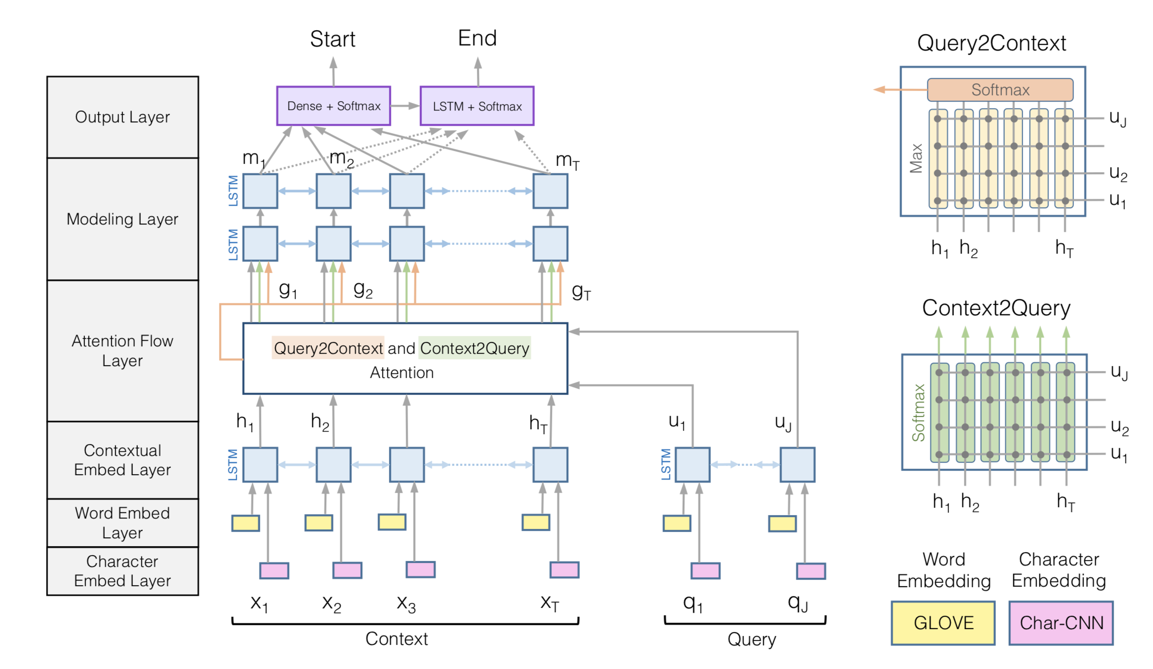
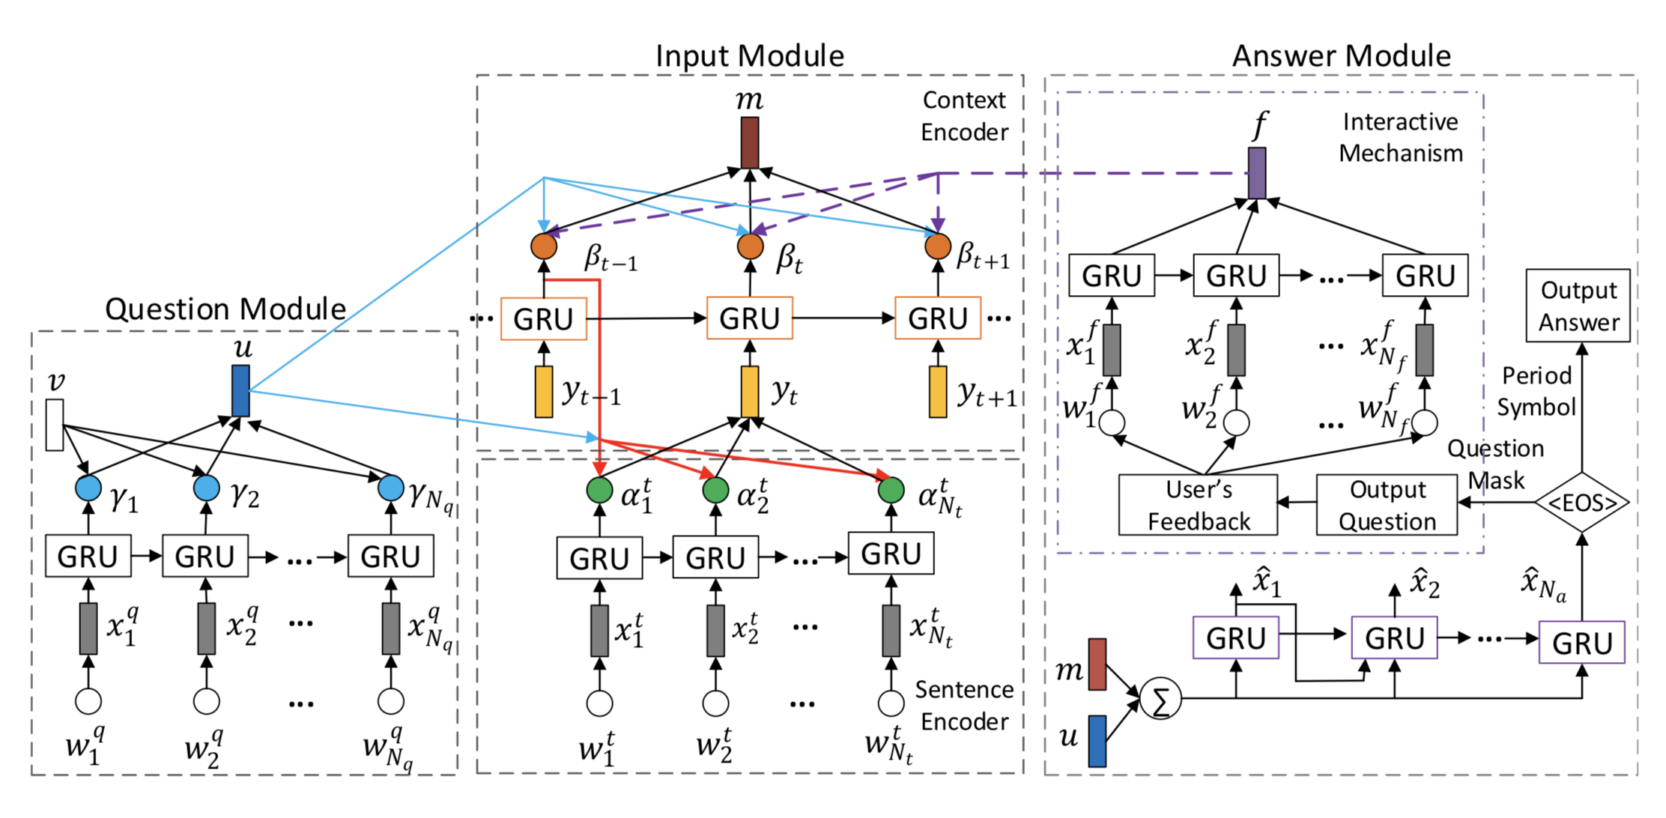
We have seen numerous systems

Slide 12
So…
Which one to select ?
What are the pros and cons ?
Is the MCQA training data unbiased and easily available ?
Notes:
So, it is clear that humans cannot keep up with so much information, coming from so many domains!
And if that’s case then machines must help!

Slide 13
Hence…
We propose a survey comparing various MCQA systems both quantitatively and qualitatively
Highlight the anomalies in various MCQA datasets
Notes:
So, it is clear that humans cannot keep up with so much information, coming from so many domains!
And if that’s case then machines must help!
Active voice

Slide 14
MCQA datasets

Slide 15
ARC, 4th and 8th grade Science QA dataset
Question] George wants to warm his hands quickly by rubbing them. Which skin surface will produce the most heat?
1. Dry palms 2. Wet palms 3. Palms covered with oil 4. Palms covered with lotion

Slide 16
Multi-hop MCQA dataset (OpenBookQA, Mihaylov et.al, 2018)
Question ] Which of these would let the most heat travel through?
1] New pair of jeans
2] A steel spoon in a cafeteria
3] A cotton candy at a store
4] A calvin klein cotton hat
Science Fact: Metal is a thermal conductor.
Common Knowledge: Steel is made of metal. Heat travels through a thermal conductor.

Slide 17
Multi-hop reading comprehension QA
Multiple sentence reading comprehension (MultiRC) (Kashabi et al., 2018)
(SENT 0): The driver of the Facel Vega car, Michel Gallimard, who was Camus’s publisher and close friend, also died in the accident.”, (SENT 1): ”In August 2011, the Milan newspaper Corriere della Sera reported a theory that the writer had been the victim of a Soviet plot, but Camus’s biographer, Olivier Todd, did not consider it credible.”, (SENT 2): ’Camus was buried in the Lourmarin Cemetery, Lourmarin, Vaucluse, France.’, (SENT 3): ’He was the second-youngest recipient, at the age of 44, of the Nobel Prize in Literature, after Rudyard Kipling, at the age of 42.’, (SENT 4): ’He was survived by his wife and twin son and daughter, Jean and Catherine, who hold the copyrights to his work.’, (SENT 5): ”Two of Camus’s works were published posthumously.”, (SENT 6): ”The first, entitled A Happy Death (1970), featured a character named Patrice Meursault, comparable to The Stranger’s Meursault.”, (SENT 7): ’There is scholarly debate as to the relationship between the two books.’, (SENT 8): ’The second was an unfinished novel, The First Man (1995), which Camus was writing before he died.’, (SENT 9): ’The novel was an autobiographical work about his childhood in Algeria.
Question - Which novel did Camus write about his childhood in Nigeria?
Answer - The First Man
Notes:
Speak out the example.

Slide 18
Anomalies in MCQA datasets
Dataset | Anamolies | Impact
ARC | There are many more supporting facts for the correct answers when compared to the incorrect | High ARC easy scores with simple IR methods (e.g., BM25) (Yadav et al., 2019a)
OpenBookQA | Contains artificial non-natural language questions | State-of-the-art performance can be achieved by just using question and candidate answer text (Mihaylov et al., 2018) alone.
MultiRC | None, other than slightly smaller in size compared to other multi-hop datasets like HotPotQA | NN models like BERT achieve similar performance as that of simple logistic regression model (Khashabi et al., 2018a)

Slide 19
Types of MCQA systems

Slide 20
Methods
Statistical NLP (SNLP)
Information Retreival (IR)
Artificial Intelligence (AI)

Slide 21
Statistical NLP (SNLP)
Machine Learning
Feedforward and Recurrent Neural Networks (RNN) systems
Transformers based – BERT, Xlnet, RoBERTa

Slide 22
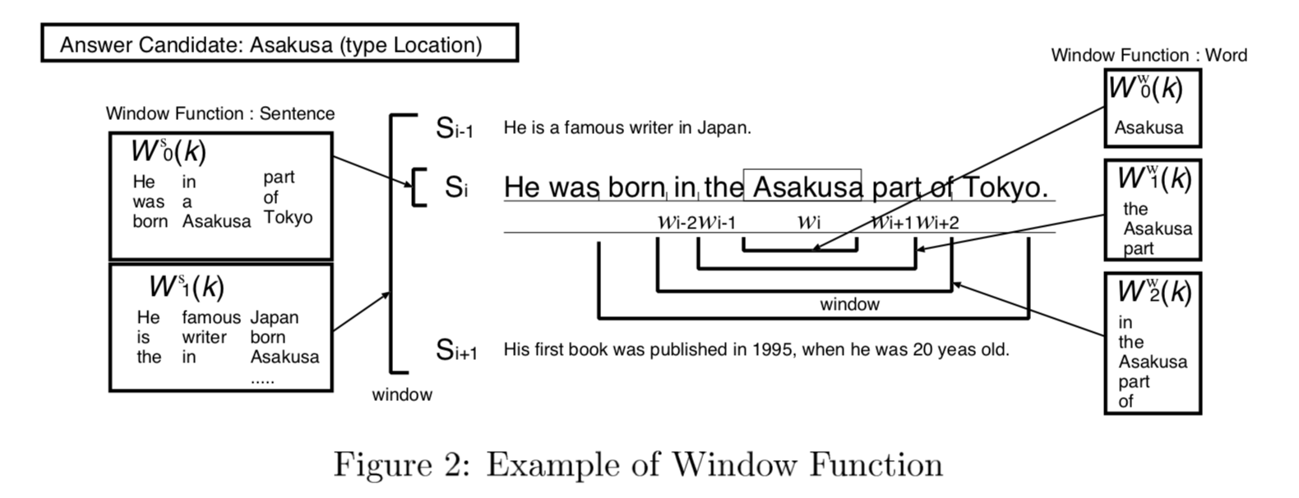
Statistical NLP (SNLP)
Machine Learning – Support vector machines(SVM), hidden markov model HMM, etc.
Image taken from Suzuki et al. (2002)

Slide 23
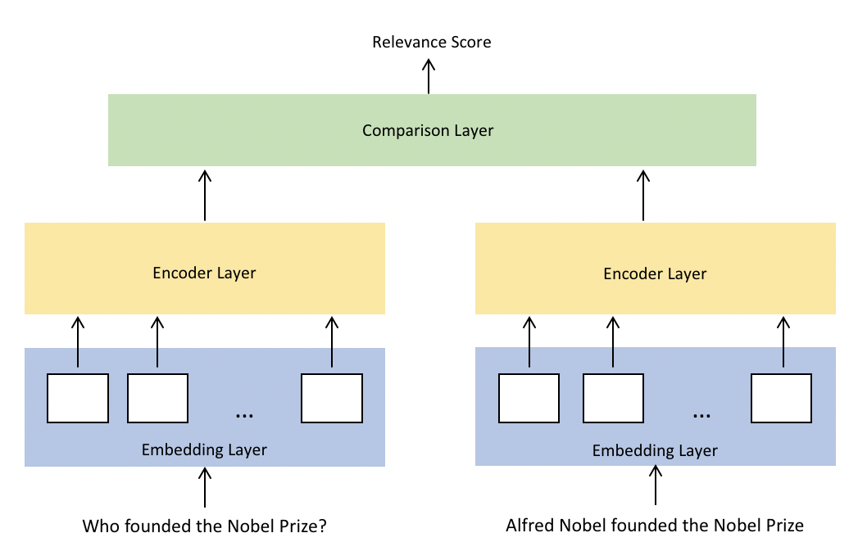
Statistical NLP (SNLP)
Feedforward and Recurrent Neural Networks Systems
Image taken from Lai et al., (2018)

Slide 24
Statistical NLP (SNLP)
Transformers based – BERT, Xlnet, RoBERTa
Image taken from link

Slide 25
Information Retrieval (IR)
Conventional IR – BM25, Point wise mutual information (PMI)
Alignment based IR – Sanity Check (SIGIR 2018), AHE (NAACL 2019)
IR supporting SNLP – AutoROCC (EMNLP 2019)

Slide 26
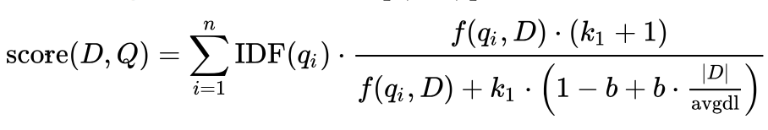
Information Retrieval (IR)
Conventional IR – BM25, Point wise mutual information (PMI)
where f(qi, D) is term frequency in the document D, |D| is the length of the document D in words, and avgdl is the average document length in the text collection from which documents are drawn. K1 and b are free parameters.

Slide 27
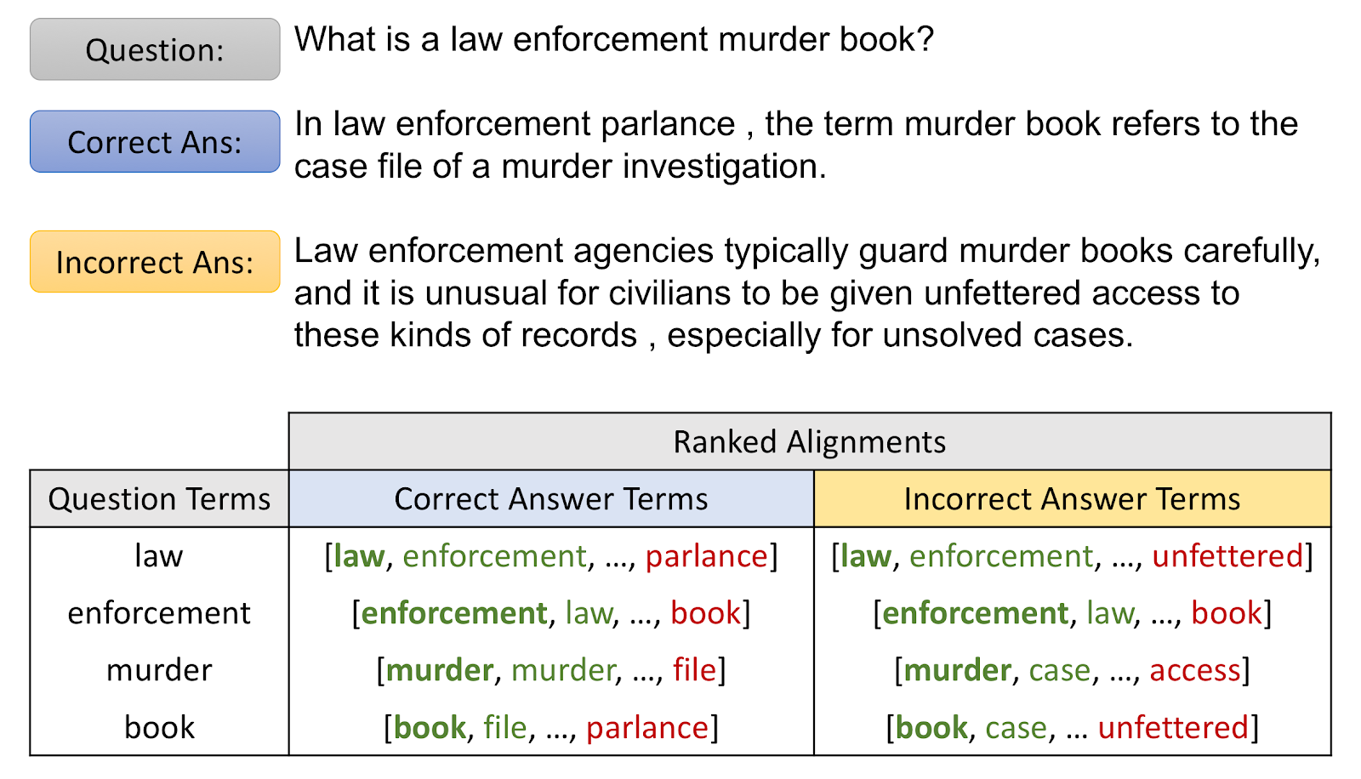
Information Retrieval (IR)
Alignment based IR – Sanity Check (SIGIR 18), AHE (NAACL 2019)

Slide 28
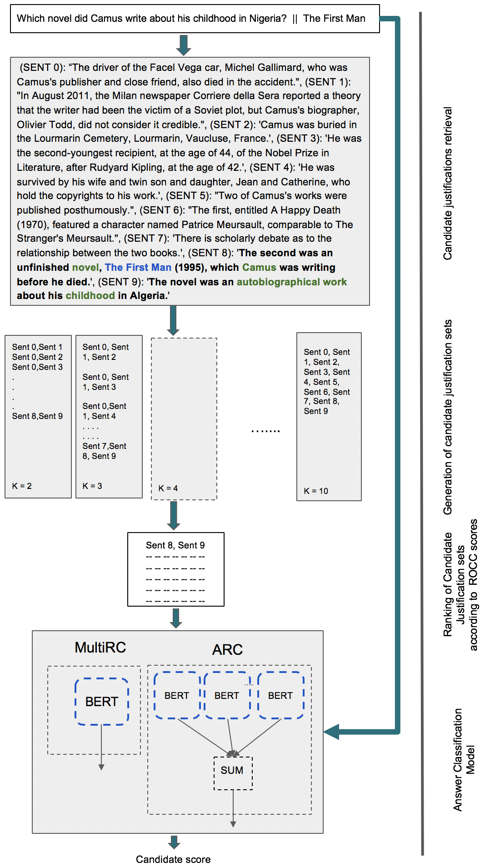
Information Retrieval (IR)
IR supporting SNLP –
AutoROCC (EMNLP 2019)

Slide 29
Artificial Intelligence (AI)
Integer Linear Programming
Graph based QA models

Slide 30
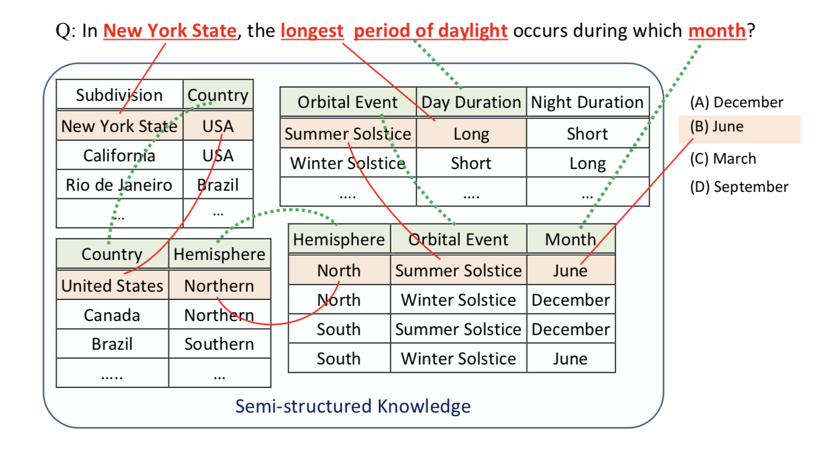
Artificial Intelligence (AI)
Integer Linear Programming
Image taken from Kashabi et al. (2018)

Slide 31
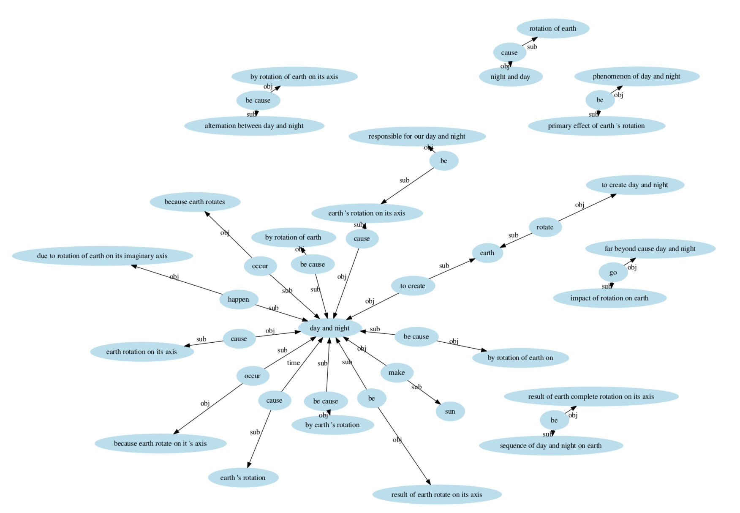
Artificial Intelligence (AI)
Graph based QA models
Image taken from Zhang et al. (2018)

Slide 32
Performance comparison

Slide 33
Performance comparison (ARC dataset)
# | Supervised ? | Type of KB | Model | Easy P@1 | Challenge P@1
IR | No | Text | BM25 (IR Solver) | 60 | 24
IR | No | Text | AHE (Yadav et al., 2019) | 65.2 | 33.7
SNLP | Yes | -- | Bi-LSTM max-out (Mihaylov et al., 2018) | 34.3 | 33.9
SNLP | Yes | Text + Structured | ET-RR (Ni et al., 2018) | - | 36.56
SNLP | Yes | Text | GPT - Reading Strategies (Sun et al., 2018) | 63.5 | 33.9
SNLP | Yes | Text | AutoROCC+BERT (Yadav et al., 2019) | 64.5 | 41.2
AI | Yes | Text + Structured | KG2 (Zhang et al., 2018) | - | 31.7
AI | Yes | Text + Structured | DGEM (Clark et al., 2018) | 59 | 27.1
AI | Yes | Text + Structured | Tuple-Inf (Clark et al., 2018) | 60.7 | 23.8

Slide 34
Performance comparison
Achieve good performance across both sets
# | Supervised ? | Type of KB | Model | Easy P@1 | Challenge P@1
IR | No | Text | BM25 (IR Solver) | 60 | 24
IR | No | Text | AHE (Yadav et al., 2019) | 65.2 | 33.7
SNLP | Yes | -- | Bi-LSTM max-out (Mihaylov et al., 2018) | 34.3 | 33.9
SNLP | Yes | Text + Structured | ET-RR (Ni et al., 2018) | - | 36.56
SNLP | Yes | Text | GPT - Reading Strategies (Sun et al., 2018) | 63.2 | 42.2
SNLP | Yes | Text | AutoROCC+BERT (Yadav et al., 2019) | 64.5 | 41.2
AI | Yes | Text + Structured | KG2 (Zhang et al., 2018) | - | 31.7
AI | Yes | Text + Structured | DGEM (Clark et al., 2018) | 59 | 27.1
AI | Yes | Text + Structured | Tuple-Inf (Clark et al., 2018) | 60.7 | 23.8

Slide 35
Performance comparison
Fail terribly on Easy set
# | Supervised ? | Type of KB | Model | Easy P@1 | Challenge P@1
IR | No | Text | BM25 (IR Solver) | 60 | 24
IR | No | Text | AHE (Yadav et al., 2019) | 65.2 | 33.7
SNLP | Yes | -- | Bi-LSTM max-out (Mihaylov et al., 2018) | 34.3 | 33.9
SNLP | Yes | Text + Structured | ET-RR (Ni et al., 2018) | - | 36.56
SNLP | Yes | Text | GPT - Reading Strategies (Sun et al., 2018) | 63.2 | 42.2
SNLP | Yes | Text | AutoROCC+BERT (Yadav et al., 2019) | 64.5 | 41.2
AI | Yes | Text + Structured | KG2 (Zhang et al., 2018) | - | 31.7
AI | Yes | Text + Structured | DGEM (Clark et al., 2018) | 59 | 27.1
AI | Yes | Text + Structured | Tuple-Inf (Clark et al., 2018) | 60.7 | 23.8

Slide 36
Performance comparison
# | Supervised ? | Type of KB | Model | Easy P@1 | Challenge P@1
IR | No | Text | BM25 (IR Solver) | 60 | 24
IR | No | Text | AHE (Yadav et al., 2019) | 65.2 | 33.7
SNLP | Yes | -- | Bi-LSTM max-out (Mihaylov et al., 2018) | 34.3 | 33.9
SNLP | Yes | Text + Structured | ET-RR (Ni et al., 2018) | - | 36.56
SNLP | Yes | Text | GPT - Reading Strategies (Sun et al., 2018) | 63.2 | 42.2
SNLP | Yes | Text | AutoROCC+BERT (Yadav et al., 2019) | 64.5 | 41.2
AI | Yes | Text + Structured | KG2 (Zhang et al., 2018) | - | 31.7
AI | Yes | Text + Structured | DGEM (Clark et al., 2018) | 59 | 27.1
AI | Yes | Text + Structured | Tuple-Inf (Clark et al., 2018) | 60.7 | 23.8
Fail terribly on Challenge set

Slide 37
Performance comparison
# | Supervised ? | Type of KB | Model | Easy P@1 | Challenge P@1
IR | No | Text | BM25 (IR Solver) | 60 | 24
IR | No | Text | AHE (Yadav et al., 2019) | 65.2 | 33.7
SNLP | Yes | -- | Bi-LSTM max-out (Mihaylov et al., 2018) | 34.3 | 33.9
SNLP | Yes | Text + Structured | ET-RR (Ni et al., 2018) | - | 36.56
SNLP | Yes | Text | GPT - Reading Strategies (Sun et al., 2018) | 63.2 | 42.2
SNLP | Yes | Text | AutoROCC+BERT (Yadav et al., 2019) | 64.5 | 41.2
AI | Yes | Text + Structured | KG2 (Zhang et al., 2018) | - | 31.7
AI | Yes | Text + Structured | DGEM (Clark et al., 2018) | 59 | 27.1
AI | Yes | Text + Structured | Tuple-Inf (Clark et al., 2018) | 60.7 | 23.8
Transformer
architecture based models indeed outperform previous approaches

Slide 38
Qualitative analysis – Domain Robustness

Slide 39
Domain robustness
Train\Test | ARC Easy (P@1) | ARC Challenge (P@1) | WikiQA (MRR)
ARC Easy | 34.3 | 23.1 | 38.7
ARC Challenge | 27.0 | 33.9 | 39.1
WikiQA | 25.8 | 24.3 | 67.4
Train\Test | ARC Easy (P@1) | ARC Challenge (P@1) | WikiQA (MRR)
ARC Easy | 38.8 | 24.1 | 53.9
ARC Challenge | 36.2 | 26.4 | 41.5
WikiQA | 38.4 | 25.4 | 71.2
AHE | 64.6 | 33.9 | 68.5
AHE | 64.6 | 33.9 | 68.5
Domain robustness of Bi-LSTM Maxout model (Mihaylov et al., 2018) which achieves state-of-the-art on ARC challenge.
Domain robustness of BiMPM model (Wang et al., 2017) which achieves one of the top performance on WikiQA.
Notes:
Row is the training and column is testing
Speak out an example -

Slide 40
Domain robustness
Train\Test | ARC Easy (P@1) | ARC Challenge (P@1) | WikiQA (MRR)
ARC Easy | 34.3 | 23.1 | 38.7
ARC Challenge | 27.0 | 33.9 | 39.1
WikiQA | 25.8 | 24.3 | 67.4
Train\Test | ARC Easy (P@1) | ARC Challenge (P@1) | WikiQA (MRR)
ARC Easy | 38.8 | 24.1 | 53.9
ARC Challenge | 36.2 | 26.4 | 41.5
WikiQA | 38.4 | 25.4 | 71.2
AHE | 64.6 | 33.9 | 68.5
AHE | 64.6 | 33.9 | 68.5
Domain transfer of Bi-LSTM Maxout (Mihaylov et al., 2018)
Domain transfer of BiMPM (Wang et al., 2017)
Notes:
Row is the training and column is testing
Speak out an example -

Slide 41
Domain robustness
Train\Test | ARC Easy (P@1) | ARC Challenge (P@1) | WikiQA (MRR)
ARC Easy | 34.3 | 23.1 | 38.7
ARC Challenge | 27.0 | 33.9 | 39.1
WikiQA | 25.8 | 24.3 | 67.4
Train\Test | ARC Easy (P@1) | ARC Challenge (P@1) | WikiQA (MRR)
ARC Easy | 38.8 | 24.1 | 53.9
ARC Challenge | 36.2 | 26.4 | 41.5
WikiQA | 38.4 | 25.4 | 71.2
AHE | 64.6 | 33.9 | 68.5
AHE | 64.6 | 33.9 | 68.5
Domain transfer of Bi-LSTM Maxout (Mihaylov et al., 2018)
Domain transfer of BiMPM (Wang et al., 2017)

Slide 42
Domain robustness
Train\Test | ARC Easy (P@1) | ARC Challenge (P@1) | WikiQA (MRR)
ARC Easy | 34.3 | 23.1 | 38.7
ARC Challenge | 27.0 | 33.9 | 39.1
WikiQA | 25.8 | 24.3 | 67.4
Train\Test | ARC Easy (P@1) | ARC Challenge (P@1) | WikiQA (MRR)
ARC Easy | 38.8 | 24.1 | 53.9
ARC Challenge | 36.2 | 26.4 | 41.5
WikiQA | 38.4 | 25.4 | 71.2
AHE | 64.6 | 33.9 | 68.5
AHE | 64.6 | 33.9 | 68.5
Domain transfer of Bi-LSTM Maxout (Mihaylov et al., 2018)
Domain transfer of BiMPM (Wang et al., 2017)

Slide 43
Conclusion
Despite its simplicity, IR approaches obtain good performance across the 2 sets of ARC.
IR techniques are more generalizable (or domain robust) when compared to SNLP methods.
We need more high quality annotated question answering data

Slide 44
Thank you! Questions?

